Slide 1

Project in the course
Data Intelligence Applications
by Nicola Gatti and Alessandro Nuara
Pricing & Advertising
Carlo Augusto Vitellio
Federico Capello
Filippo Fedeli
Gianmarco Genalti
Jean Paul Guglielmo Baroni

Slide 2





TEAM
Carlo Augusto Vitellio
Federico Capello
Filippo Fedeli
Gianmarco Genalti
Jean Paul Guglielmo Baroni

Slide 3



















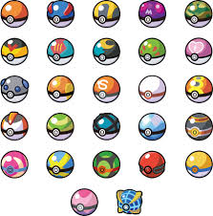






1.
Product to sell

Slide 4


Arezzo Football Team Merchandising
T-shirt price range €50.00 - €70.00

Slide 5
Binary features:
Season Ticket Holder / Casual Customer
Younger audience (16 - 25 yo) / Adult audience (26+)

Slide 6
Classes of users
Young Season Ticket Holder
Adult Season Ticket Holder
Casual Customer

Slide 7
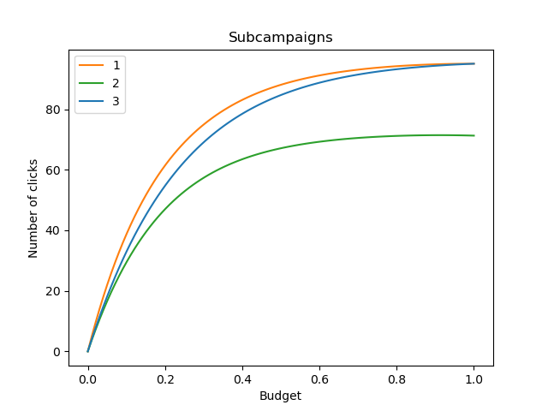
Advertising
In order to understand how to split our budget for advertising, we imagine how the three classes of users would react to an ad with the given budget
The algorithm will try to learn this information to achieve the best budget allocation

Slide 8
2.
Single Phase Advertising
ads generate
clicks
3 ads
GPTS
bandit problem
for advertising
budget allocation
on ads
knapsack-like problem
to reallocate budget
Notes:
Spiegazione problema
Dobbiamo spiegare cos’è un gpts?

Slide 9
ads generate
clicks
3 ads
GPTS
bandit problem
for advertising
budget allocation
on ads
knapsack-like problem
to reallocate budget

Slide 10
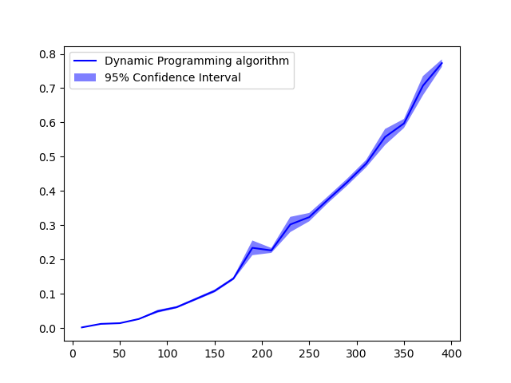
Optimization Algorithm
30 experiments every 10 arms
We implemented the dynamic programming algorithm in order to solve the knapsack-like optimization problem.
As predicted from the theory, keeping fixed the number of subcampaigns (at N = 3), time scales quadratically in the number of values for the daily budget (K).
The complexity is:
O(NK²)
Time [s]
# of arms

Slide 11
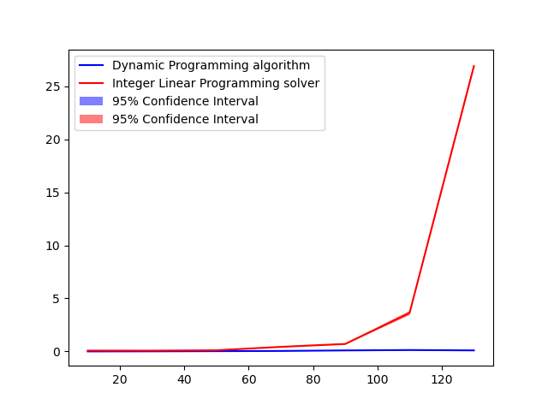
Optimization Algorithm
Comparison with the ILP solver
Our algorithm is tailor-made for this problem: it strongly outperforms the standard Integer Linear Programming formulation (implemented with Pulp), showing a clear asymptotical difference
Time [s]
# of arms

Slide 12
ads generate
clicks
3 ads
GPTS
bandit problem
for advertising
budget allocation
on ads
knapsack-like problem
to reallocate budget

Slide 13
ads generate
clicks
3 ads
GPTS
bandit problem
for advertising
budget allocation
on ads
knapsack-like problem
to reallocate budget

Slide 14

How it was done
The initialization of the split was, initially, totally random.
This, however, led to situations where one campaign, initialized to 0, was promptly seen as useless and therefore not learned properly, due to the gaussian process kernel function.
Therefore, we decided to implement a random initialization in a stricter domain, never allowing a campaign to start too close to 0. An alternative would be an initial even split.
Notes:
Accennare al restart fatto nei punti 6 e 7

Slide 15
ads generate
clicks
3 ads
GPTS
bandit problem
for advertising
budget allocation
on ads
knapsack-like problem
to reallocate budget

Slide 16
ads generate
clicks
3 ads
GPTS
bandit problem
for advertising
budget allocation
on ads
knapsack-like problem
to reallocate budget

Slide 17

How it was done
Hyperparameters are tuned before running the experiments, in order to reduce the computational load. We make the assumption to have previous data on which we are able to tune them.
We repeated the experiment multiple times in order to have stable and significative results, averaging the obtained regrets.
Notes:
Specificare kernel (dire che si è provato altri kernels)

Slide 18
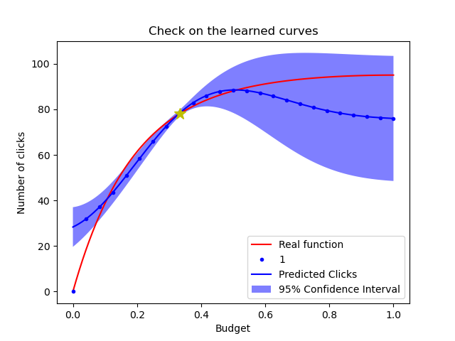
Notes:
Spiegare perché abbiamo fissato a zero click lo zero budget

Slide 19
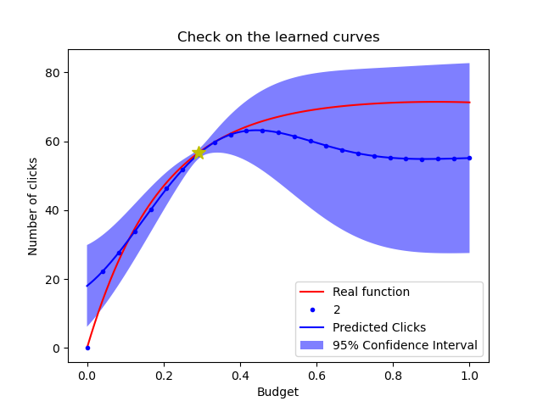

Slide 20
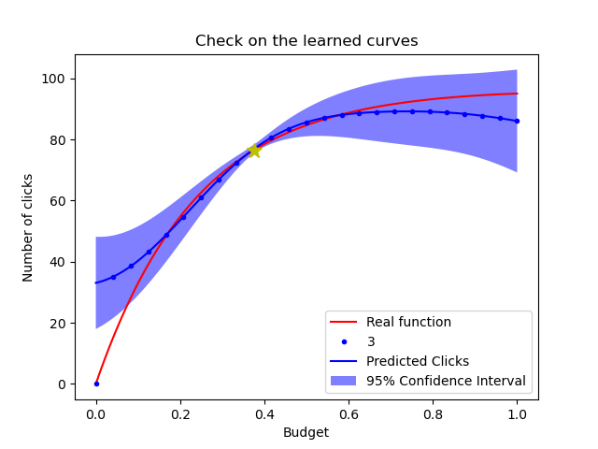

Slide 21

Observations
Looking at the learned curves’ confidence intervals, it is evident how some points are less explored. It is normal as our goal is not to learn the function, it is to maximise the profits. As the curves are shaped like this, it makes sense not to examine the points close to 1, as the marginal utility is lower.
As we see from the theory, the regret appears logarithmic in time.

Slide 22
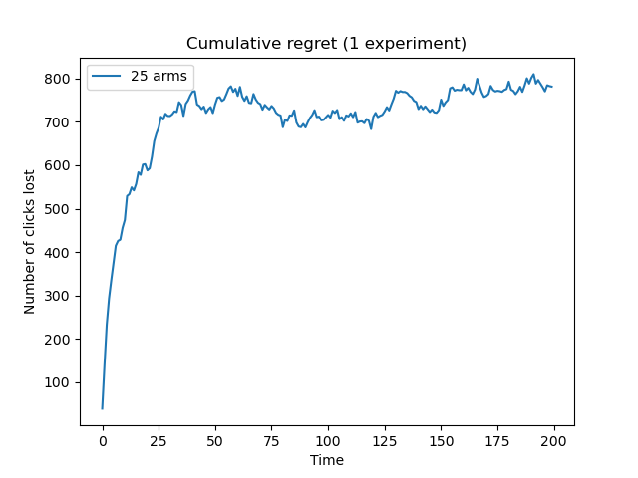

Slide 23

Observations
Using less arms, we expect the exploration to be faster, resulting in a small loss of clicks at the beginning
However, in the long term we would get to a worse optimum, due to the loss of granularity

Slide 24
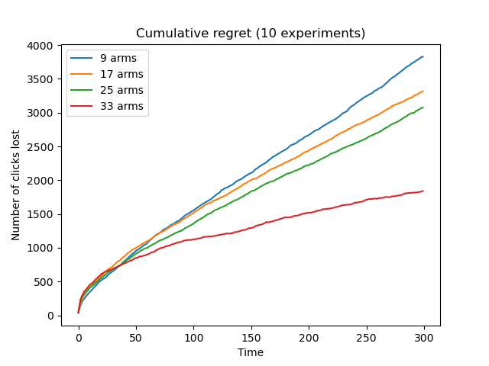
Further Experiments
We can see that, initially, with less arms it performs better, but, asymptotically, the regret for 33 arms becomes the best.
NB: this is only true if the increasing sets of arms contain the previous sets of arms, like in this case. Otherwise, there could be better optimums with less arms
Notes:
Aggiungiamo braccia a ogni insieme - Spiegare gli insiemi di braccia scelti (perché proprio 9, 17,...) Dire vagamente perché sono pseudo-lineari

Slide 25
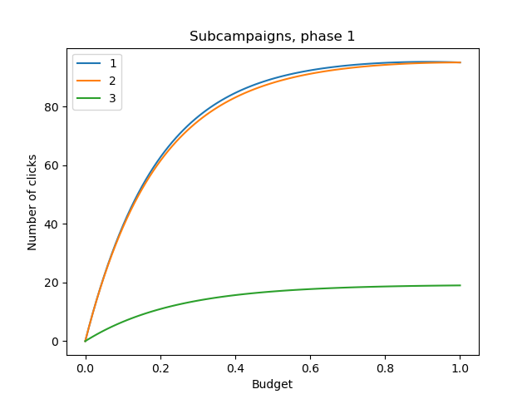
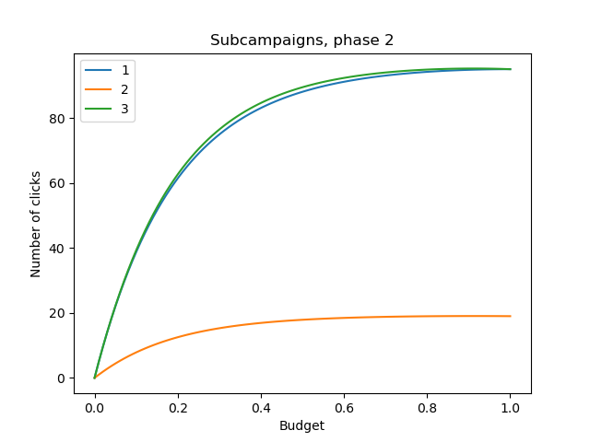
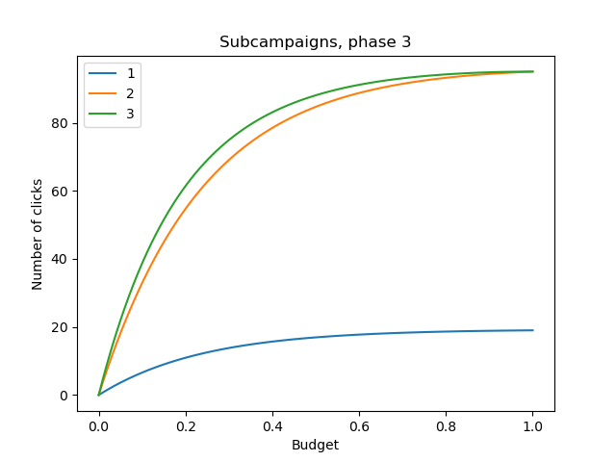
3.
Multiple Phases Advertising
Notes:
Richiesta del punto 3.
Perché abbiamo scelto curve fatte così

Slide 26
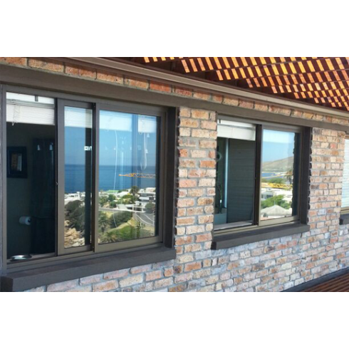
We proceed as in the single case scenario. However, we use a Sliding Window Gaussian Process Thompson Sampling, in order to adapt to the abrupt change of phases

Slide 27
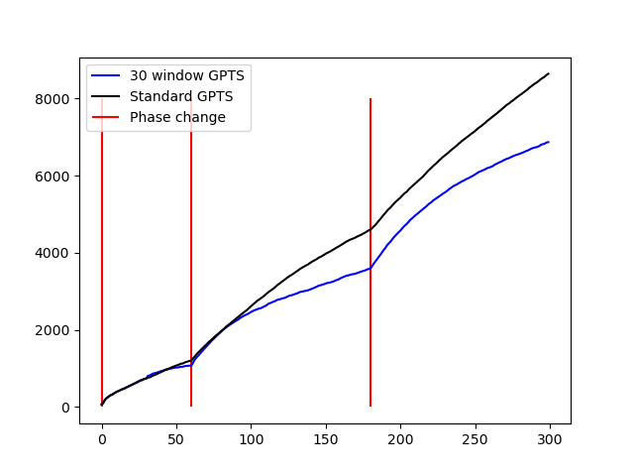
Cumulative Regret (20 experiments)

Slide 28
It is easy to notice that, at the beginning, the two Thompson Sampling algorithms perform equally well
However, when the phase changes, the sliding window allows the algorithm to quickly adapt, while the standard algorithm is much slower, as it does not forget the past values
Notes:
SW è più rapido a cambiare idea su ogni campagna pubblicitaria, quindi si adatta meglio alla situazione del caso

Slide 29
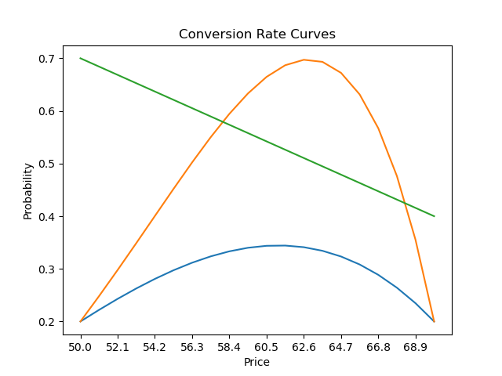
Pricing
In order to price the product, we need to imagine how to market responds to a given price.
Some Conversion Rate Curves are created in order to find the probability for which an user clicks on the product given the current price
This is displayed for every subcampaign

Slide 30
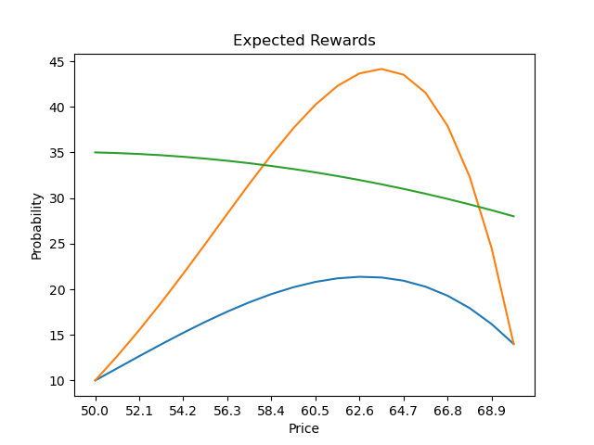
Pricing
Therefore, we can work out the expected reward for every price and for every subcampaign, multiplying the price by its probability
This information is not available to the algorithm, which will try to learn the most convenient price by itself.
The expected reward can instead reveal the ideal best price, usable as a benchmark
Notes:
Sarà un po’ il nostro obiettivo nella fase succesiva

Slide 31
4.
Aggregated Subcampaigns Pricing
advertising
pricing
different
classes
of users
generated
clicks
bandit problem
for pricing
generated
revenue
same
price
for all classes

Slide 32

Aggregated subcampaigns
The price is fixed for all users, but every class will react differently to a given price
We deployed only one Thompson Sampling Algorithm in order to solve the bandit problem
When conversion rate curves have consistently different shapes we expect a higher regret, as the best arm for one class will not probably be the best for the other classes

Slide 33
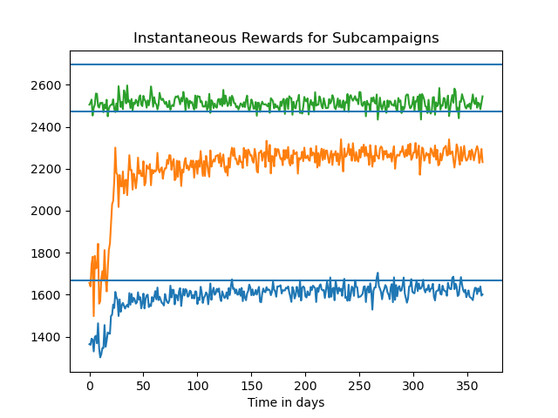

Slide 34
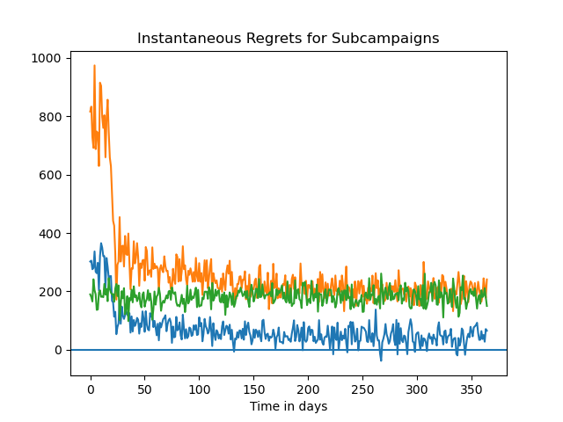

Slide 35
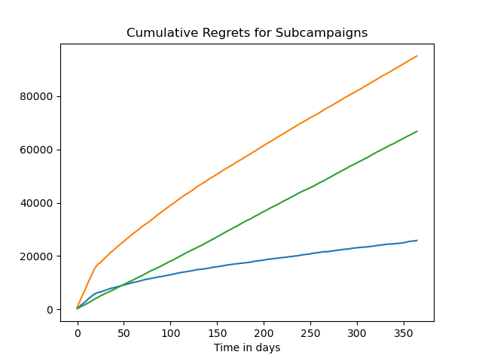

Slide 36
As we expected, the price is optimized properly for only one class (blue)
For the same price on the other two classes, the optimum is not reached and the regret performs linearly (orange and green)

Slide 37
5.
Context Generation Pricing
advertising
pricing
different
classes
of users
generated
clicks
bandit problem
for pricing
generated
revenue
different
prices
for each context
contexts
generation

Slide 38

Context Generation
We use an online-learning approach to estimate context probabilities and potential rewards
Periodic “split checks” are performed to verify if one or more contexts are being underexploited
Multiple TS Learners specialize over the new, splitted contexts
67% of the times we manage to obtain the correct splits: the green function is divided from the other two
The remaining 33% of the times the split is not optimal, but this is due to stochastic fluctuations

Slide 39
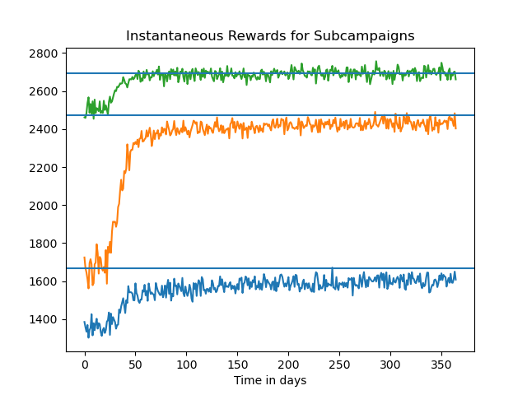

Slide 40
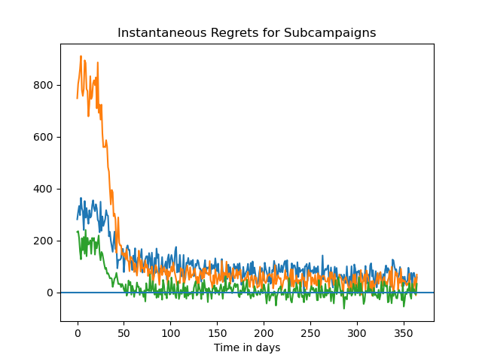

Slide 41
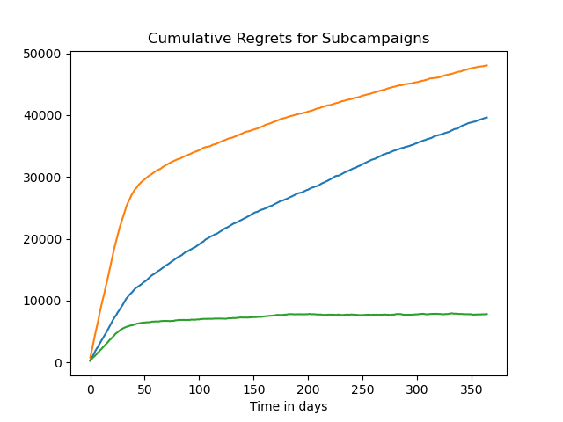

Slide 42
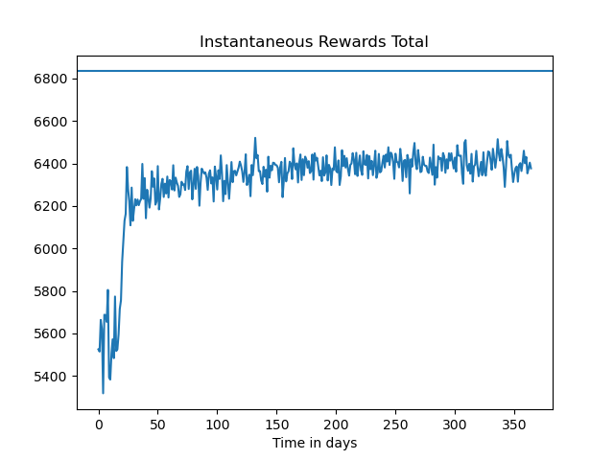
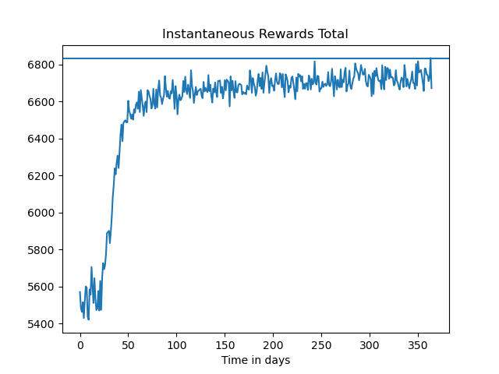
Instantaneous Rewards
Subcampaigns aggregated
Subcampaigns splitted

Slide 43
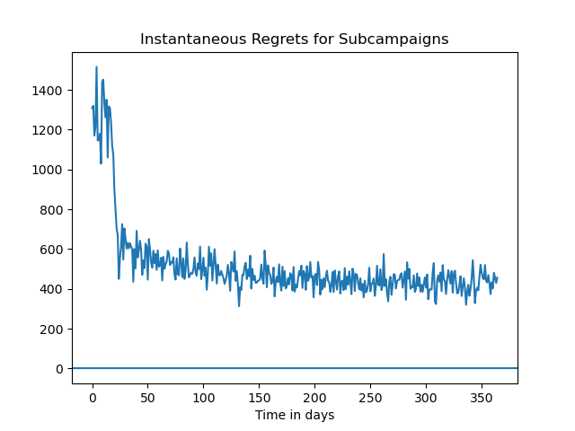
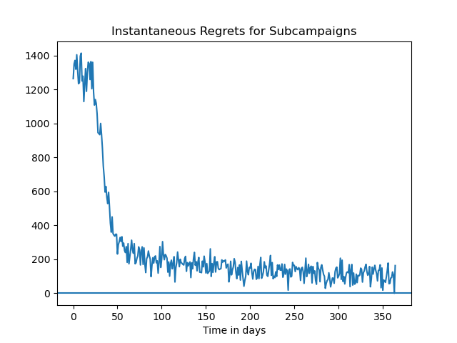
Instantaneous Regrets
Subcampaigns aggregated
Subcampaigns splitted

Slide 44
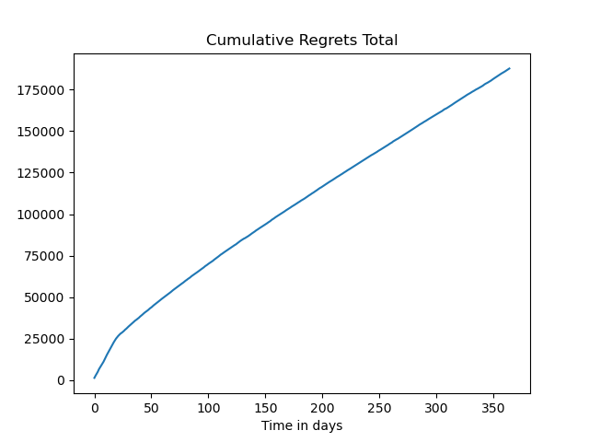
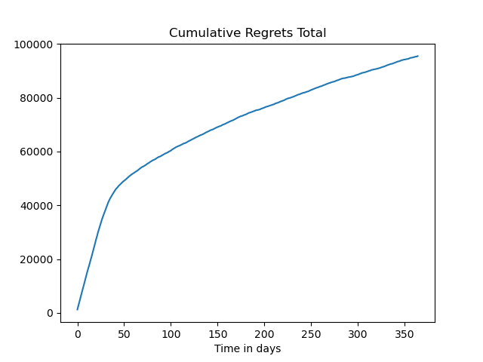
Cumulative Regrets
Subcampaigns aggregated
Subcampaigns splitted

Slide 45
6.
Advertising and Pricing Integrated
ads generate
clicks
clicks used to learn the
best prices
3 ads
generated
revenue
budget allocation
on ads
knapsack-like problem
to reallocate budget

Slide 46

6. Advertising & Pricing Integrated
Here the Advertising and the Pricing parts are integrated in one
The ads generate 3 numbers of clicks based on the given budgets
Then the prices are determined using a Thompson Sampling Algorithm
The data for the generated revenue is exploited by the Gaussian Process Thompson Sampling to perform a new budget allocation
The cycle is repeated in such fashion to get the 3 best ad budget allocations and product prices

Slide 47
7.
Advertising and Single Pricing Integrated
ads generate
clicks
3 ads
clicks used to learn the
best single price
generated
revenue
budget allocation
on ads
knapsack-like problem
to reallocate budget

Slide 48
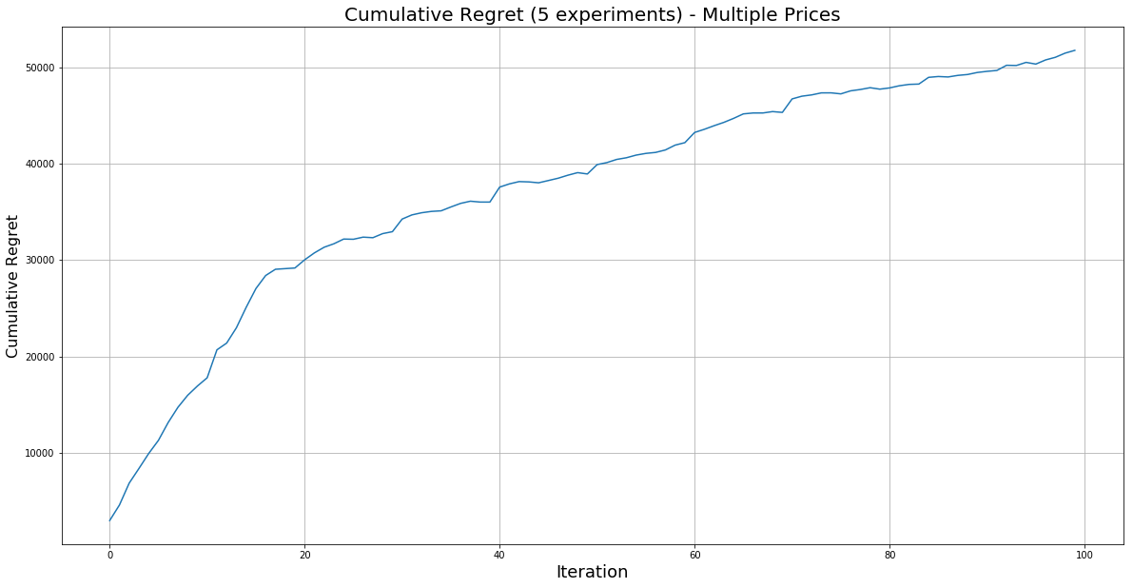
Multiple Prices - Results
with Restart technique

Slide 49
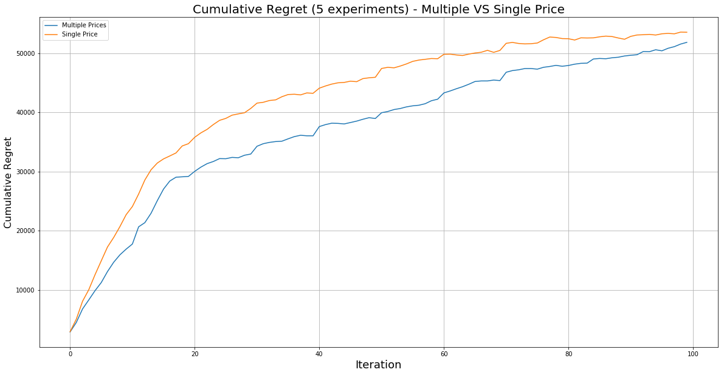
Multiple vs Single Price - Results
with Restart technique

Slide 50
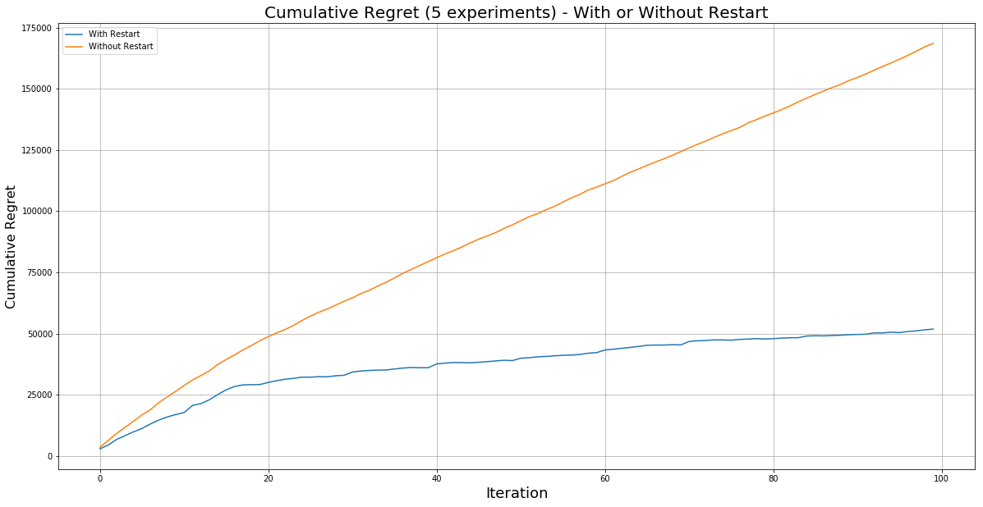
Restart - With or Without

Slide 51

Thank you

